Slide 1
A 21st Century Approach to Stable Ischemic Heart Disease
David L. Brown, MD, FACC
Professor of Medicine
@DavidLBrownMD
Missouri ACP
Lake of the Ozarks, MO
September 21, 2019

Slide 2
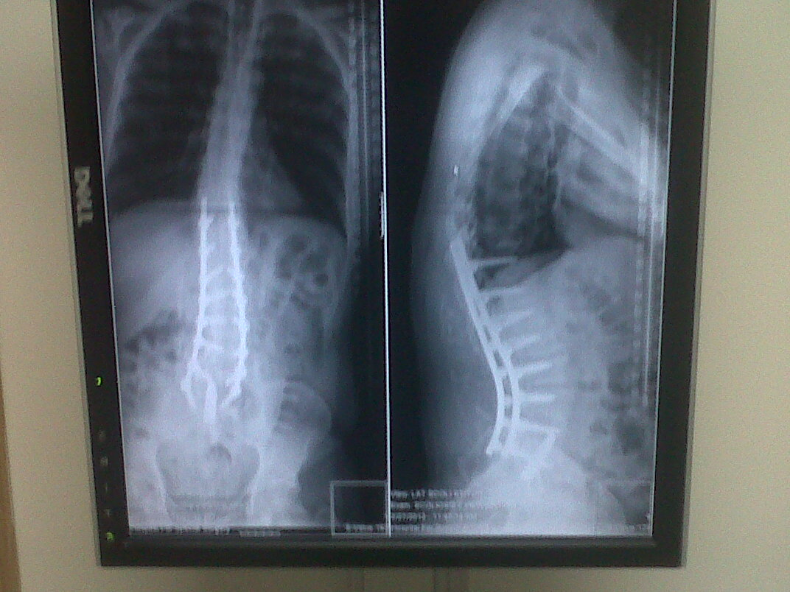
Disclosure
No conflicts
I practiced interventional cardiology for 19 years before becoming a general cardiologist in 2012

Slide 3
Debate Topic:
Initial PCI vs. Medical Therapy for Symptomatic Stable Ischemic Heart Disease
Question:
Does PCI improve outcomes for symptomatic stable ischemic heart disease patients, in the absence of acute coronary plaque rupture, compared to optimal medical therapy?

Slide 4
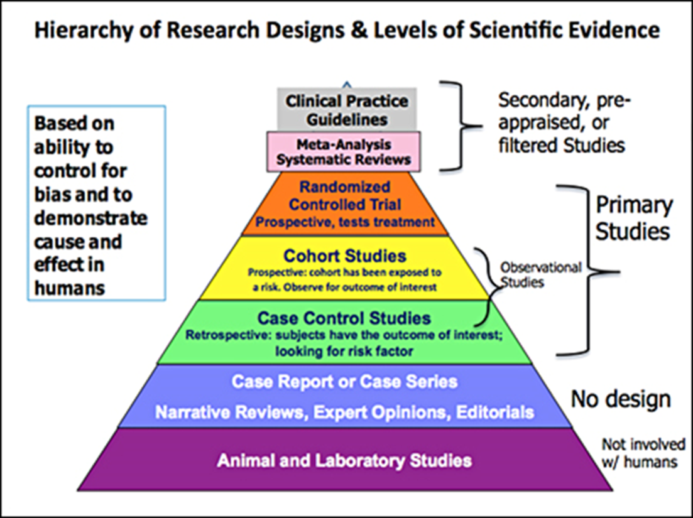
"if you have no data, you're just another person with an opinion"

Slide 5
Background

Slide 6
Taxonomy of Ischemic Coronary Syndromes:
(What’s in a Name?)
Acute Coronary Syndromes
  Sudden cardiac death
  ST-elevation myocardial infarction
  Non-ST-elevation myocardial infarction
  Unstable angina
Stable Ischemic Heart Disease
  Implies a single entity with a single cause and a single treatment
Notes:
Existing taxonomy considers SCAD a single entity with a single cause and a single treatment. It does not imply ischemia. Myocardial involvement is implied in ACS and not required in SCAD.

Slide 7
Prevalence of Stable Angina
~8.7 million Americans (M=F) have stable angina
565,000 new cases per year

Slide 8
Goals of Treatment
Improve Quantity of Life
  Prevent death and MI
Improve Quality of Life
  Relieve angina
Spend as little of society’s money as possible

Slide 9
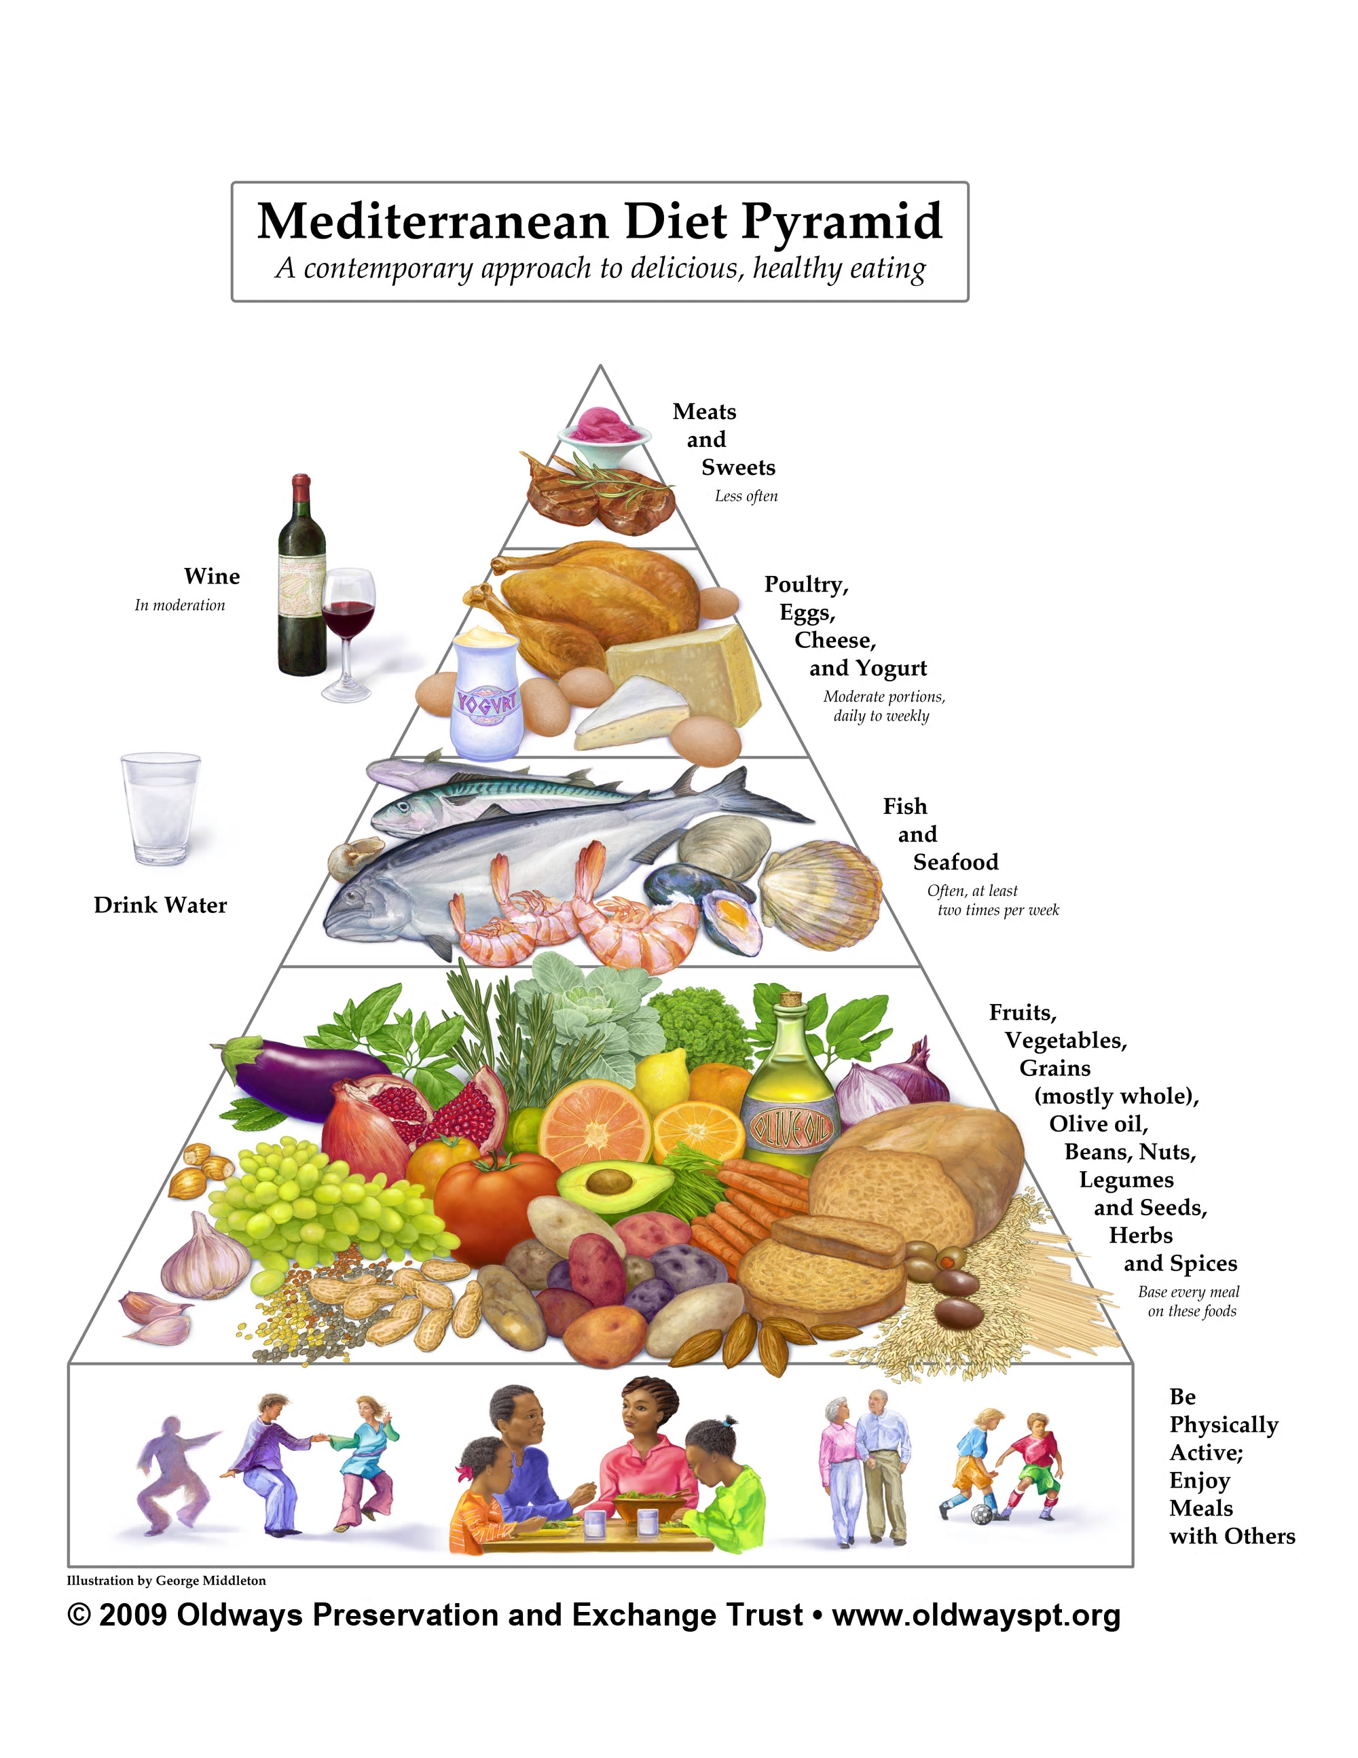

OMT in 2019
Aspirin or clopidogrel
Disease-modifying therapy
  ACE/ARB
  High potency statin
Anti-ischemic therapy
  Beta blockers
  Calcium channel blockers
  Nitrates
Mediterranean diet
Regular Exercise/Cardiac Rehab
Smoking Cessation
BP and glycemic control
Weight loss

Slide 10
Facts

Slide 11
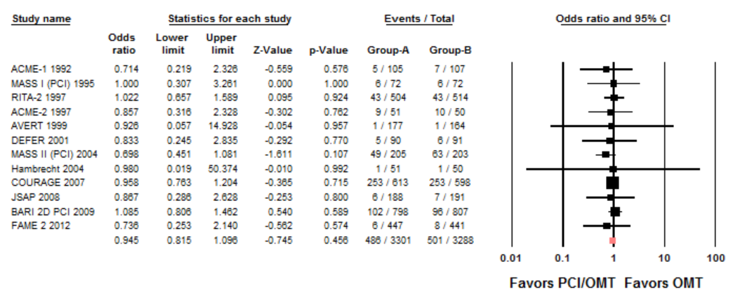
Fact #1:
PCI Does Not Reduce Mortality in SIHD
12 RCT’s; N=6589.
Mitchell JD, Brown DL. JAHA. 2017.
Notes:
First RCT 7 years after Gruentzig’s death

Slide 12
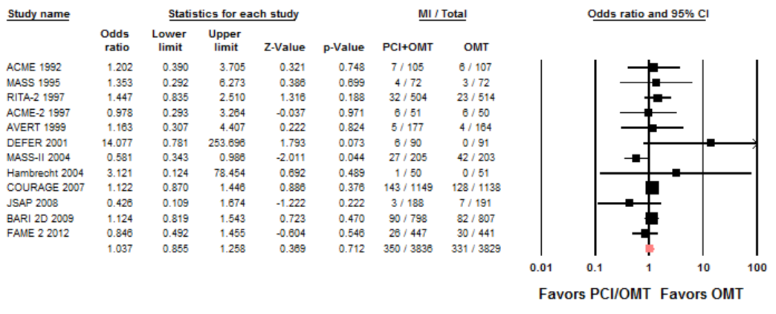
Fact #2:
PCI Does Not Prevent MI in SIHD
12 RCT’s; N=7665.
Mitchell JD, Brown DL. JAHA 2017.

Slide 13
Fact #3:
No High-Risk SIHD Subgroups Benefit from PCI
High-Risk Subsets | Worse Outcomes (Death, MI) | Outcomes Improved by PCI
Diabetics | Yes | No
Diabetics with high-risk anatomy | Yes | No
Older patients | Yes | No
Low LVEF | Yes | No
More extensive CAD | Yes | No
3V CAD + low LVEF | Yes | No
Proximal LAD | Yes | No
Chronic kidney disease | Yes | No

Slide 14
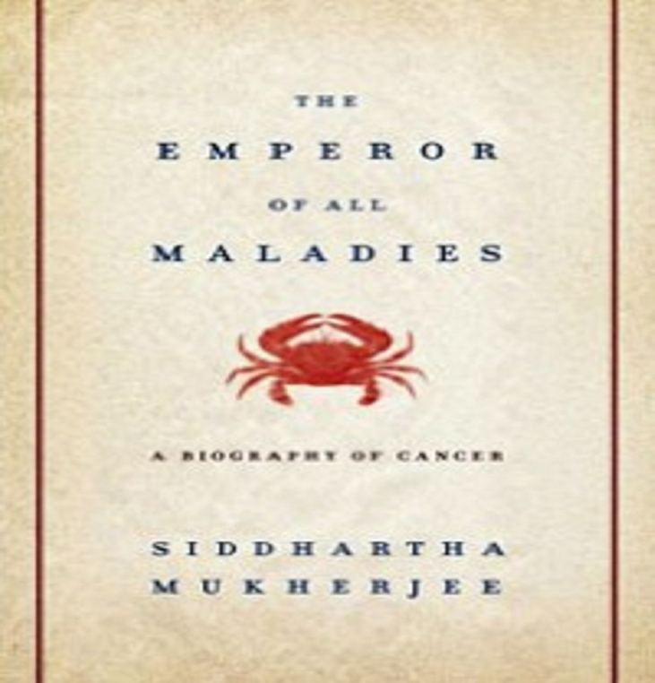

Fact #4:
PCI Does Not Improve Death, MI in Patients with Ischemia
I S C H E M I A
JAMA Intern Med. 2014;174(2):232–240

Slide 15
Fact #5:
PCI Is Not Effective Therapy for Angina
N=1784 patients with angina at the time of randomization

Slide 16
ORBITA
Lancet 2018; 391: 31 - 40
Principle Hypothesis: PCI increases exercise time more than a sham procedure
Sample size calculation: To detect an increase in exercise time of 30 seconds with 80% power and a SD of 75 seconds requires 200 randomized patients

Slide 17
ORBITA Results Summarized
Stent compared to sham
    No significant improvement in:
    Exercise time (with 2 different statistical methods)
    Time to 1 mm ST depression
    Peak oxygen uptake
    SAQ physical limitation (with 2 different statistical methods)
    SAQ angina frequency (with 2 different statistical methods)
    SAQ angina stability
    SAQ quality of life (with 2 different statistical methods)
    EQ-5D-5L QoL (with 2 different statistical methods)
    Duke treadmill score
    CCS angina grade (with 2 different statistical methods)
    Significant improvement in:
    Peak stress wall motion index score (with 2 different statistical methods)
    Freedom from angina at 4 weeks (49.5 vs. 31.5%)

Slide 18
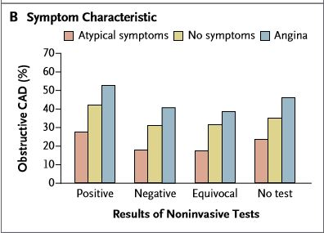
Fact #6: Half of Patients with Angina and an Abnormal Stress Test Have Do Not Obstructive CAD
N=398,978
N Engl J Med 2010; 362:886-895

Slide 19
Fact #7: Coronary Spasm is Found in 58% of Patients with Angina and Non-obstructive CAD

Slide 20
Therapy of Coronary Artery Spasm
Smoking Cessation*
Calcium Antagonists*
Long-acting Nitrates*
Statin therapy*
* Included in OMT

Slide 21
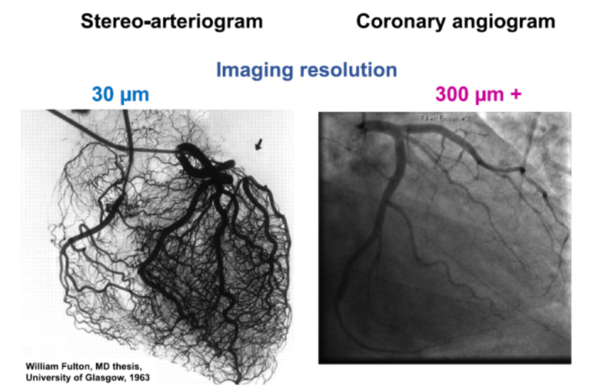
Fact #8:
90% of Resistance to Coronary Blood Flow Occurs in the Arteries Not Visible by Angiography

Slide 22
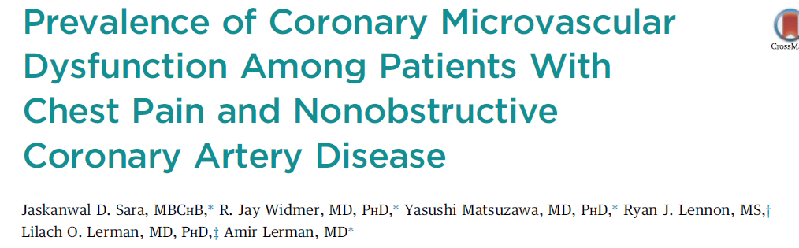
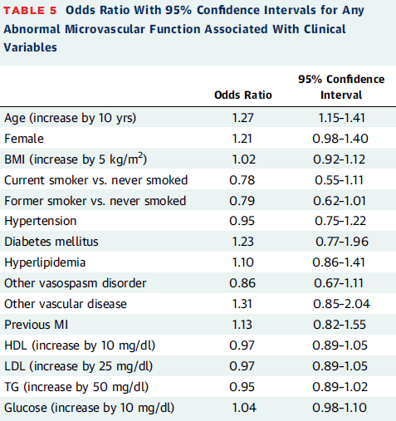
Fact #9: Microvascular Dysfunction is Found in 64% of Patients With Angina But Without Obstructive CAD
N= 1439

Slide 23
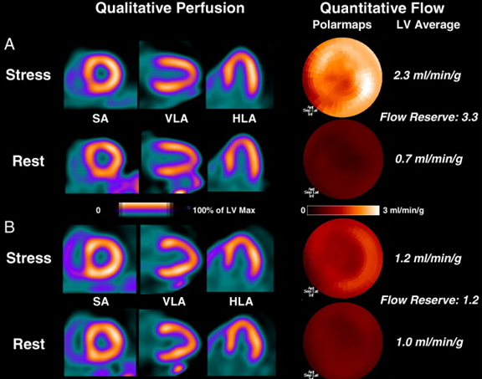
Coronary Flow Reserve by Rb-82 PET Microvascular Dysfunction
PET perfusion imaging has become the gold
standard of evaluation due to the linear relationship
between myocardial blood flow (MBF) and radioisotope
signal intensity, allowing highly accurate MBF
quantification
Normal
Diffuse /
Mild CAD
JACC 2009;54(1):1-15.

Slide 24
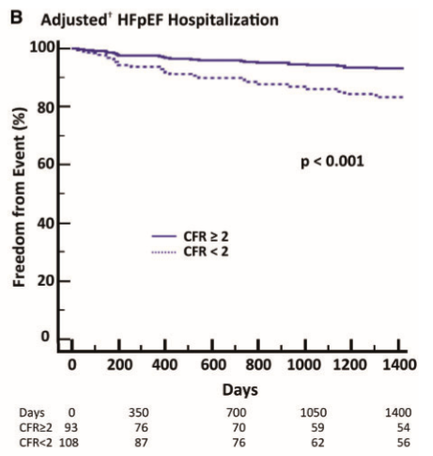
Outcomes of Patients with Microvascular Dysfunction
MACE= death, MI, revascularization, CHF admission

Slide 25
Mortality in Patients with Abnormal CFR

Slide 26
There is No Proven Treatment of Coronary Microvascular Dysfunction
*
*
*Included in OMT
European Heart Journal May 2014, 35 (17) 1101-1111

Slide 27


Slide 28
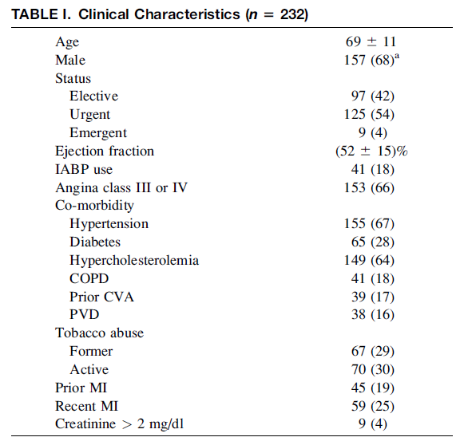
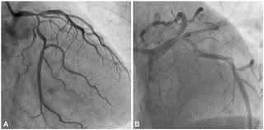
Left Main CAD
2.1% of 13,000 coronary angiograms at University of Virginia
Catheterization and Cardiovascular Interventions 67:357–362 (2006)

Slide 29
Survival: CABG vs. Medical Therapy

Slide 30
Diagnostic Modalities for Left Main CAD
Treadmill Stress Test
  No radiation, low cost, high NPV (94%), low PPV (26%)
Nuclear Stress Test
  Radiation, low sensitivity (64%), high specificity (94%)
Stress Echo
  No radiation, high NPV (100%), high PPV (100%)
Coronary CTA
  Radiation, anatomical detail, high NPV (100%), high PPV (100%)

Slide 31
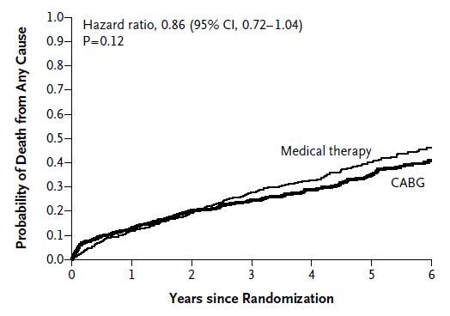
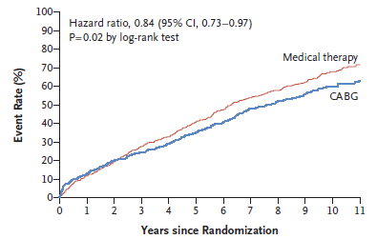
Multivessel CAD with Depressed LVEF-
STICH Trial
N Engl J Med 2011;364:1607-16.
N Engl J Med 2016;374:1511-20.
N=1212, CAD suitable for CABG, EF <35%

Slide 32
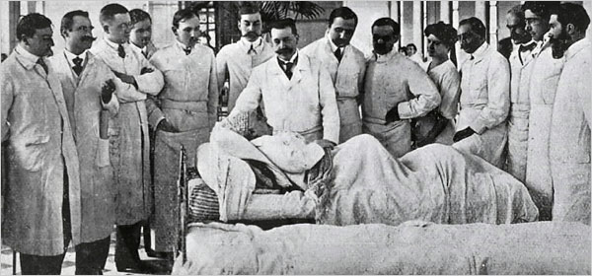
Let’s Talk About Some Real Patients
National Library of Medicine
A doctor, a patient and hospital staff in grand rounds in the 1920s.
Notes:
Looks like the Trump cabinet

Slide 33
Case #1
61-year old executive with hypertension who developed chest pain while walking briskly outside on a cold day
LDL 120 mg/dl
The pain resolved spontaneously with rest
He had one additional similar episode and presented to his PCP

Slide 34
What Next?
Exercise Stress Test
Nuclear Stress Test
Stress Echo
Coronary CT Angiogram
Cardiac Cath/PCI/CABG
Begin Medical Therapy and Reassess
Other

Slide 35
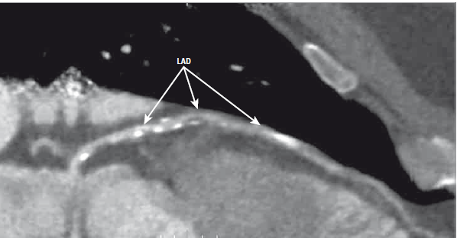
CCTA

Slide 36
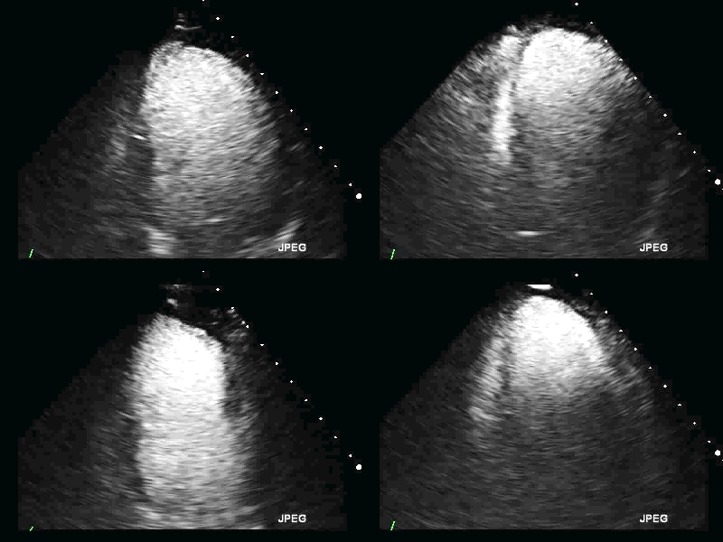
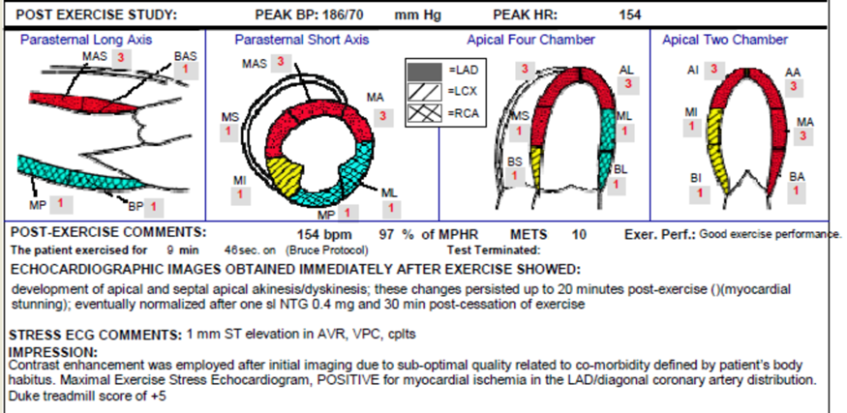
Stress Echo
Notes:
DTS = Exercise Time - (5 x Max ST) - (4 x Angina Index)
Ex Time Treadmill exercise time
Max ST Maximum net ST deviation (except aVR)
Angina Index Treadmill angina index
0. No angina during exercise
1.
Non-limiting angina
2. Exercise limited angina
DTS Duke treadmill score
Risk
>=+5 Low risk
+4 to -10
Moderate risk
<= -11 High risk

Slide 37
OMT is Medication and Lifestyle Modification

Slide 38
Case #2
41-year old man with elevated triglycerides but no history of hypertension, diabetes or smoking develops exertional chest pain at work as a construction supervisor
His pain was relieved by sublingual nitroglycerin
He had undergone 2 coronary angiograms previously that were normal
He had his gall bladder removed which did not improve his symptoms

Slide 39
What Next?
Exercise Stress Test
Nuclear Stress Test
Stress Echo
Coronary CT Angiogram
Cardiac Cath/PCI/CABG
Begin Medical Therapy and Reassess
Other

Slide 40
Repeat Coronary Angiography with Acetylcholine Injection
DX: Diffuse coronary spasm
RX: High dose diltiazem and atorvastatin

Slide 41
Case #3
73-year old woman with type 2 diabetes, obesity and exertional angina for 2 years.
Recent normal coronary angiogram

Slide 42
What Next?
Exercise Stress Test
Nuclear Stress Test
Stress Echo
Coronary CT Angiogram
Cardiac Cath/PCI/CABG
Begin Medical Therapy and Reassess
Other

Slide 43
Repeat Coronary Angiography with Physiologic Assessment
Normal FFR
Reduced CFR 1.3
No spasm induced with acetylcholine
DX: Microvascular Dysfunction
RX: Atorvastatin, lisinopril, carvedilol

Slide 44
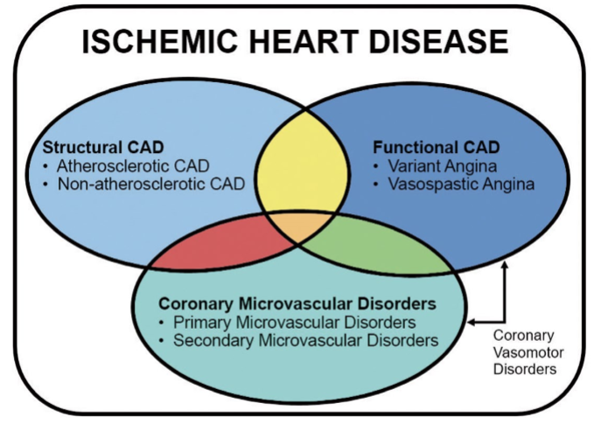
A Broader View of Myocardial Ischemia

Slide 45
My Approach to SIHD in 2019
For patients with appropriate risk factors and stable angina
  Initiate OMT
  CCTA, nuclear stress or stress echo to rule out left main disease/severe LV dysfunction-not to treat ischemia
  Consider cath for persistent angina on maximally tolerated medical therapy with acetylcholine testing to rule out spasm and measurement of coronary flow reserve OR
  Vasodilator PET scan to assess CFR
    Enroll in clinical trial if microvascular dysfunction

Slide 46
Thank You!

